Slide 1
Addressing Quality Improvement
Notes:
Good day this presentation provides you with an overview of the tools used for quality improvement in order for us to continuously aim towards a better health care system in the communities we serve

Slide 2
DoH Definition
Quality Improvement is achieving the best possible results within
available resources
‘Best possible results’ can be defined in several ways:-
Meeting standards (Ideal Clinic, National Core Standards)
Meeting targets and analysing Data
Implementation of best practice /guidelines
Notes:
The DOH’s definition is that QI is achieving the best possible results within the resources you have in your clinic. This means we aim to meet standards, meet our targets and analyse data and utimaltey implement best practice and guidelines.

Slide 3
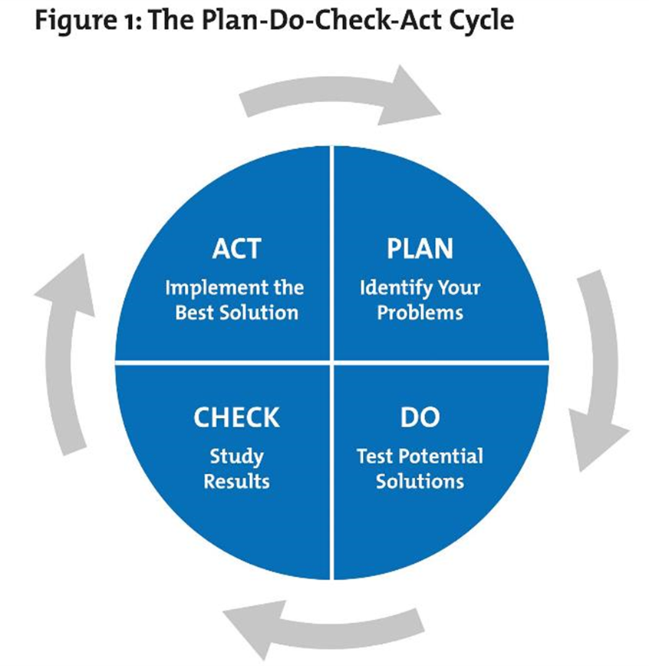
Quality Improvement
Quality Improvement is
Continuous & Cyclical
Notes:
The DOH’s definition is that QI is achieving the best possible results within the resources you have in your clinic. This means we aim to meet standards, meet our targets and analyse data and utimaltey implement best practice and guidelines.

Slide 4
Identify Gaps using DoH Tools
Notes:
The DoH recommends a few tools that assist when analysing a gap in healthcare. The following list is a guide when analyising gaps, these being a process map or flow diagram, a root cause analysis otherwise known as the Fishbone, the 5 whys, action plans and A 3 reports.

Slide 5
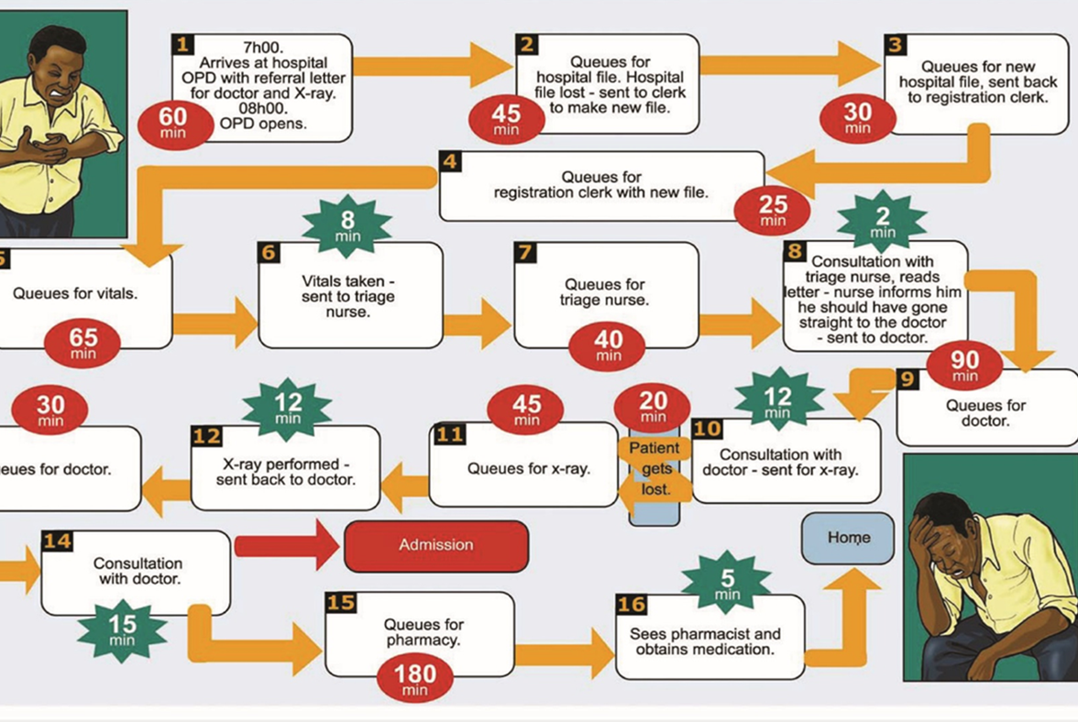
Process Mapping
Also known as a Flow Diagram
Starting and End point
Part of a larger system
Creates a visual tool in order to identify bottlenecks, duplication of effort, waste, unnecessary steps causing a problem
Team approach provides opportunity for input
Understand from the clients and staff’s perspective
Notes:
Process mapping is very useful visual tool that shows the entire system and where possible bottlenecks exist, duplication of effort, waste etc. It allows for the whole team to get involved as well as the clients. Process mapping is useful to show patient flow as in the example on the slide.

Slide 6
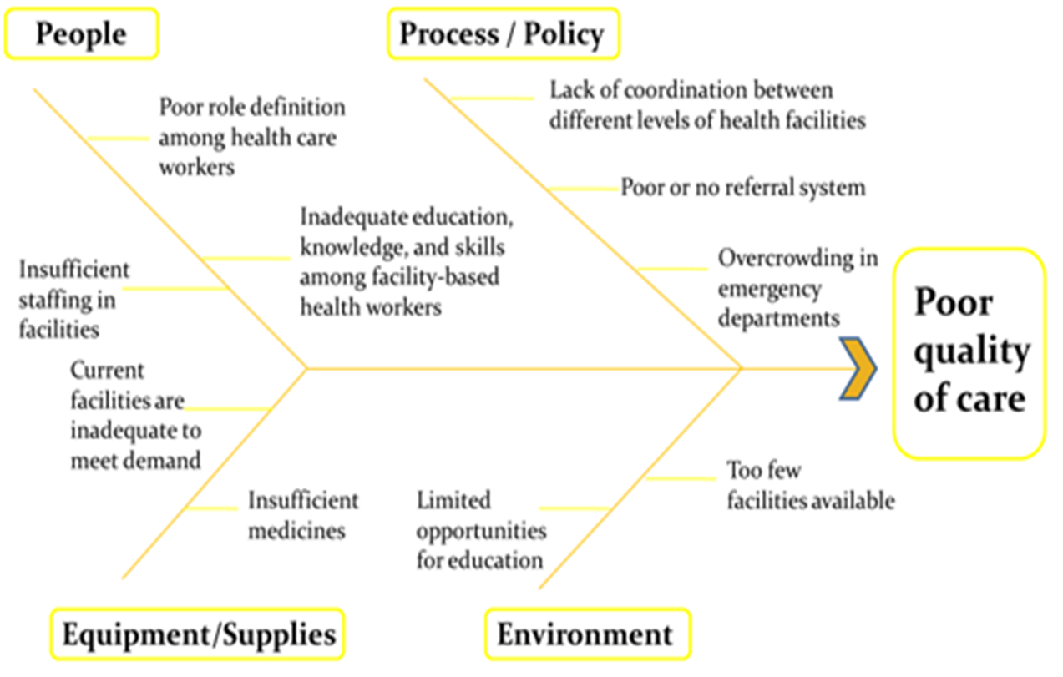
Fishbone
Explore underlying causes and identify potential solutions
Pictorial display listing a problem with associated causes
How causes related to and impact on one another
Notes:
The Fishbone explores underlying causes and potential solutions and how causes of poor quality care impact on one another and are related to one another.

Slide 7
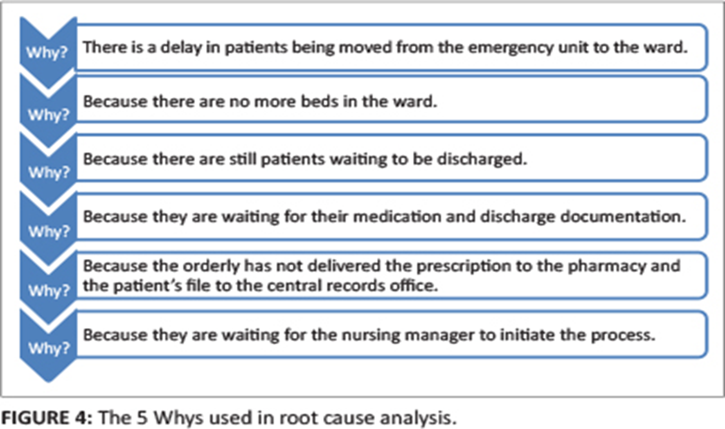
5 Why’s
Technique probing deeper into the causal chain
Tries to identify the root cause more rigorously
Notes:
The 5 whys is a very useful tool to dig deeper into the actual challenge or problem. It allows one to try and identify the root cause more rigorously. So the example above highlights a challenge in a hospital setting. One keeps asking why until one reach’s some sort of root cause. Again it is relatively simple and can be used as a team effort

Slide 8
Create ‘Ideas’
Brainstorming Ideas
Group ideas into themes
Benchmark against others
Involve patients
Group Discussions / Focus Groups
Surveys
Notes:
So now we need to create ideas to help address the challenges or gaps – so we brainstorm ideas, you can benchmark against other clinics, you can involve patients and the clinic committee, you can have discussions in the waiting area, you can also do client surveys which are already done for Ideal clinic

Slide 9
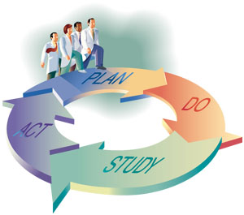
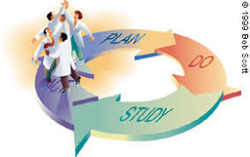
Test Ideas and Implement
Identify and test ideas generated by teams
Successful tests lead to implementation
Initially change is small scale
Use PDSA model to test
Notes:
The clinic team as a group will need to test these ideas or action plans and see if they work. So this is where your PDSA cycle comes in as useful. You have identified the gap or challenge, you have brainstormed ideas and now you testing to see if they work and improve the quality of healthcare. The change may be small and the ideas may be small but a number of small changes will make a difference

Slide 10
Adopt and Sustain Improvement
Part of the larger health system
Continually recognising improvements
Ongoing Process
Staff and management buy-in important for sustained change
Notes:
Once you have found that the idea worked, then we need to adopt it the idea and implement. But it is a continuous circle so re-visit every now and again as we on a continuous journey to make improvements over time. As said before it can be small improvements so don’t take on large tasks but smaller ones that you can celebrate as a team. All staff need to be involved for the changes to be sustained.

Slide 11
Thank You
Please feel free to contact us should you have any questions:
info@chiva-Africa.org
+27 (0) 83 500 7222
Notes:
Thank you for your participation and support. Please contact us if you need any additional guidance and support.

