Slide 1
PIVOT TABLES
CREATING PIVOT TABLES

Slide 2
OBJECTIVES
What is a pivot table
The use of pivot tables
Advantages of using a pivot table
Creating pivot tables
Reports

Slide 3
WHAT IS A PIVOT TABLE
A pivot table is a tool used to reorganise data in a spreadsheet to obtain a desired report more effectively.
This might include sums, averages, or other statistics, which the pivot table groups together in a meaningful way.
Once you create a pivot table, you can quickly transform huge numbers of rows and columns into a meaningful, nicely formatted report.

Slide 4
THE USE OF A PIVOT TABLE
A pivot table is used to summarise, sort, reorganise, group, count, total or average data stored in a table.
It allows us to transform columns into rows and rows into columns.
It allows grouping by any field (column) and using advanced calculations on them etc.

Slide 5
ADVANTAGES OF USING A PIVOT TABLE
Keeps presentation of information more organised
Provides interactive data analysis
Helps decision makers to use data more efficiently
Sums up a large amount of data into a small space
Creates report quickly
Can combine data from multiple sheets

Slide 6
CREATING A PIVOT TABLE
Export source data to excel (It will open as an excel file)
Save the excel file to your computer
Click a cell in the source data or table range.
Go to Insert > Recommended PivotTable.
Select the PivotTable that looks best to you and press OK.

Slide 7
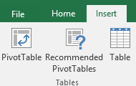
CREATING A PIVOT TABLE cont.
Select the cells you want to create a PivotTable from.
Note: Your data shouldn't have any empty rows or columns. It must have only a single-row heading.
2. Select Insert > PivotTable.

Slide 8
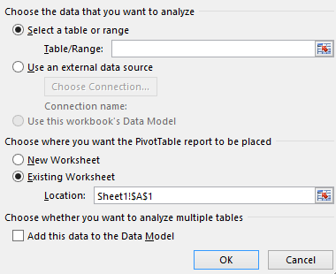
CREATING A PIVOT TABLE cont.
Under Choose the data that you want to analyze, select Select a table or range
This will create a new spreadsheet where you'll build your dynamic pivot table reports.

Slide 9
CREATING A PIVOT TABLE cont.
In Table/Range, verify the cell range.
Under Choose where you want the PivotTable report to be placed, select New worksheet to place the PivotTable in a new worksheet or Existing worksheet and then select the location you want the PivotTable to appear.
Select OK.
This will create a new spreadsheet where you'll build your dynamic pivot table reports.

Slide 10
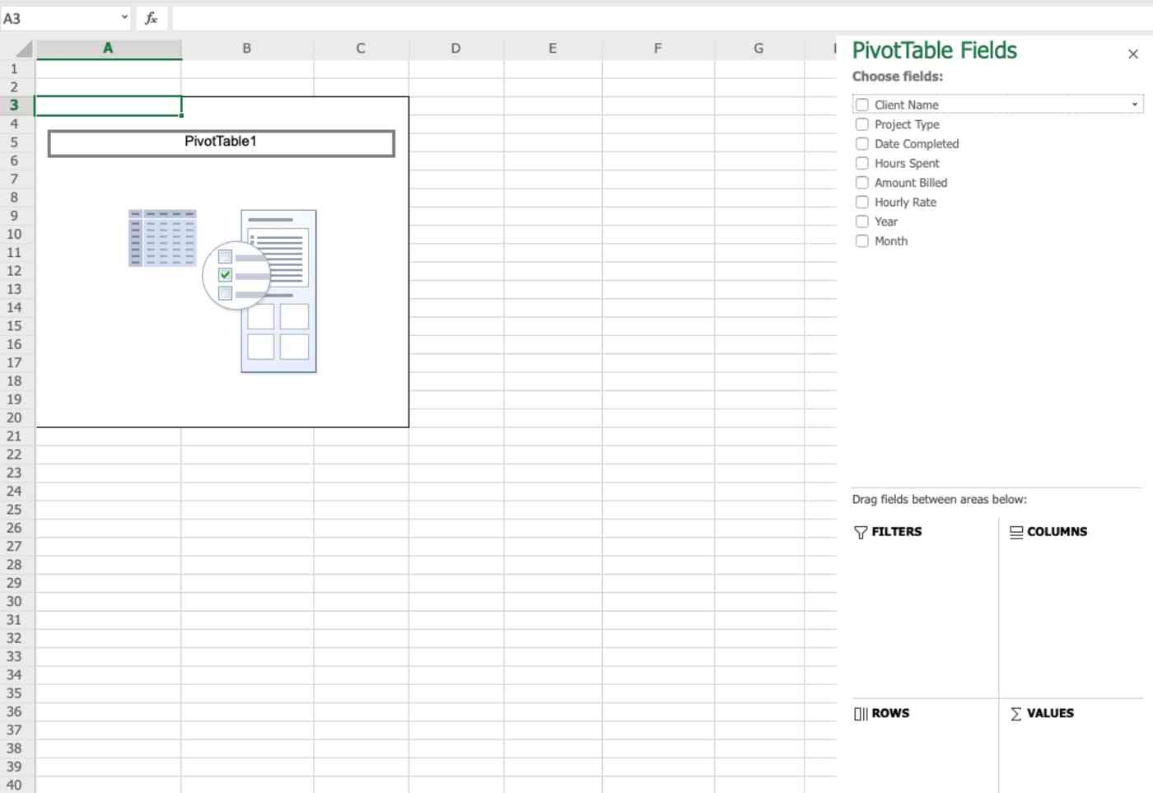
CREATING A PIVOT TABLE cont.
The process of building a pivot table in Excel Online uses drag and drop functionality.
You add a field to an area simply by dragging it there.
Don't want a field in a box anymore? Drag it out, and it disappears.
Beyond that, you'll learn how to use these tools as we go along.

Slide 11
REPORTS
A pivot table starts out empty. All you'll see on the right edge of the sheet is the pivot table editor, where you'll find all the options for building your pivot table.
The editor is divided into two horizontal sections.
The top section lists all the fields—these are all the columns from your table data.
In the bottom section, you'll find the actual area for manipulating the pivot table. It's divided into four parts: Filters, Columns, Rows, and Values

Slide 12
EXAMPLE OF A PIVOT TABLE

Slide 13
Thank You
Please feel free to contact us should you have any questions:
info@chiva-africa.org
+27 (0) 83 500 7222
Notes:
The CHIVA SA team will help assess services for adolescents and youth, identify gaps that exist and support action plans that will improve the quality of SRH services for adolescent and youth that meet the DoH guidelines and Ideal Clinic elements. Please contact us if you need any additional guidance and support.

